Slide 1

Beauty lies in the averageness: An analysis of facial attractiveness
Lam Tran
Capstone Project – Denison University

Slide 2
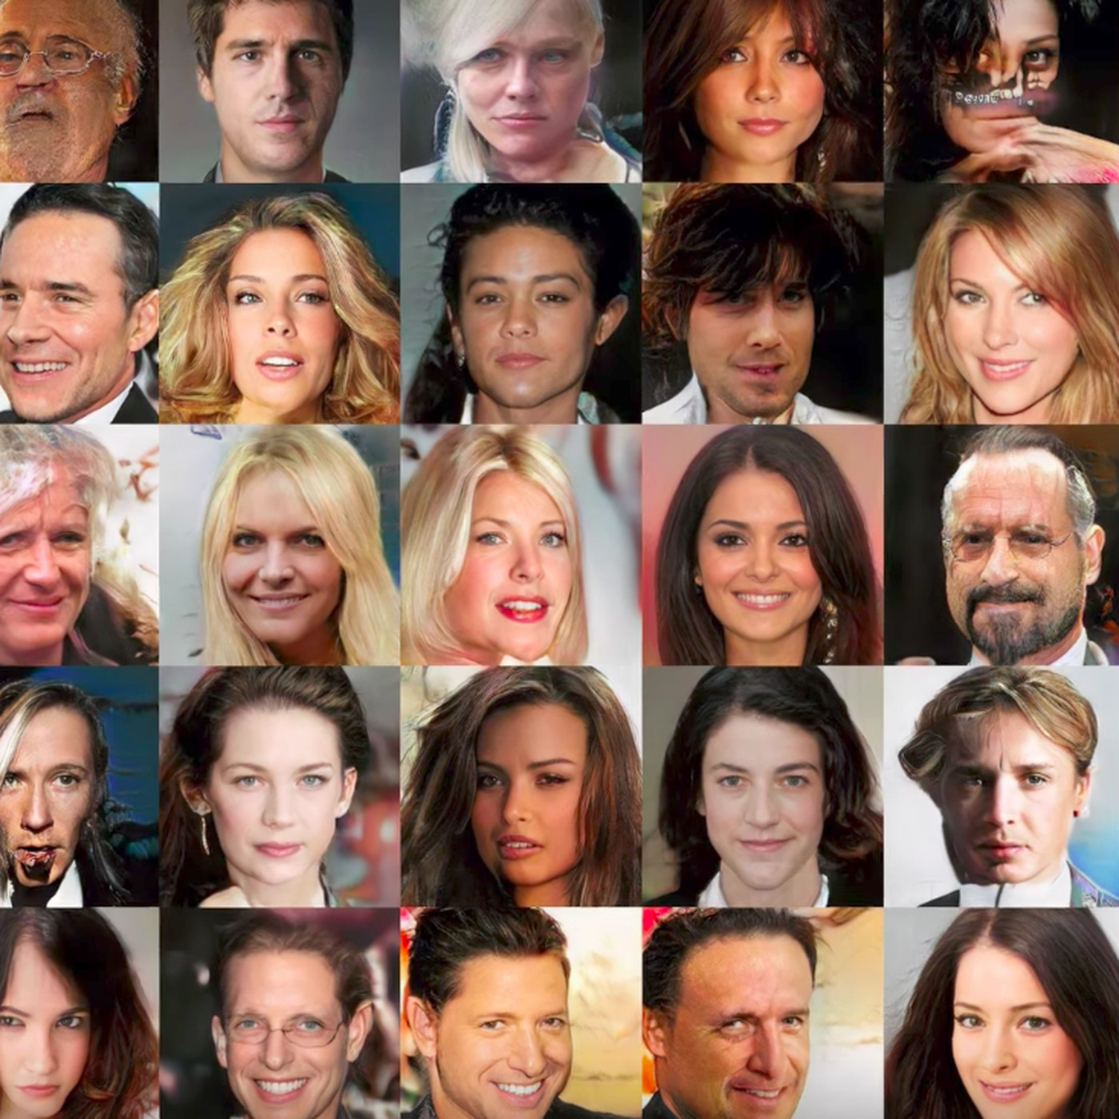
Deepfakes have great potentials in personalized or micro-targeted ads
However, fake faces need to be not only realistic, but also attractive

Slide 3
Biological Hypotheses
Beauty is NOT in the eye of the beholder
Common/average features indicate good genes and are considered attractive

Slide 4
Statement of Problem
Do people from different demographic background have the same standard of beauty?
Does possession of average/common features increase attractiveness?

Slide 5
Data
2,222 images of U.S. adults’ faces
Include attractiveness ratings (27 per image) + demographic infor of the faces + demographic infor of the raters
Distributions of races, genders, and ages follow those of the U.S. population according to 1990 Census

Slide 6
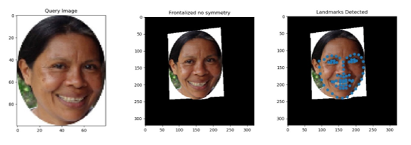
Methods
Feature Extraction and Normalization
Random Forests
Univariate Linear Regression
Exploratory Data Analysis

Slide 7
Methods
Random Forest
Univariate Linear Regression
High accuracy
Provides variable importance
=> which facial features are most important to beauty?
Provides signs of coefficients
=> does averageness positively correlated with attractiveness?

Slide 8
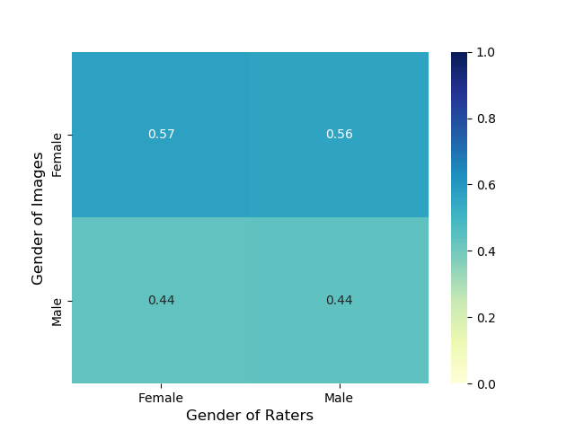
Results
Both males and females rate females as more attractive

Slide 9
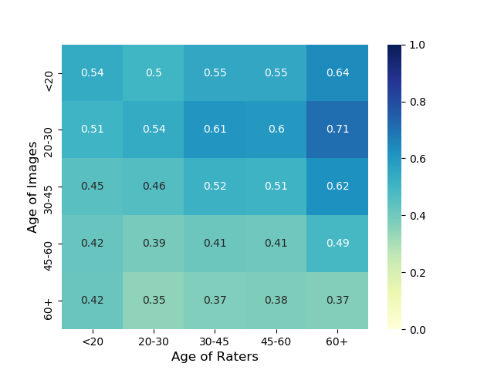
Results
20-30s are the most attractive
Older people gave higher ratings but received lower ratings

Slide 10
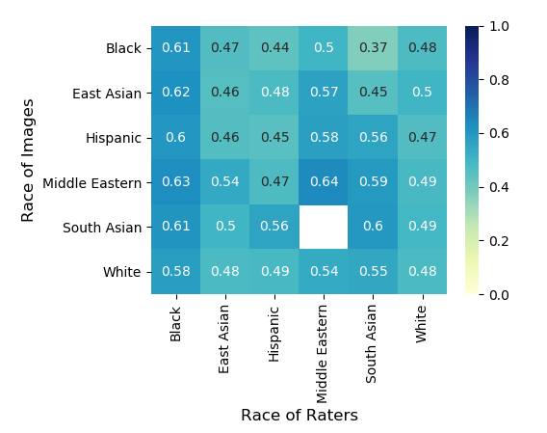
Results
- Inconsistent ratings between races => No universal standard of beauty

Slide 11
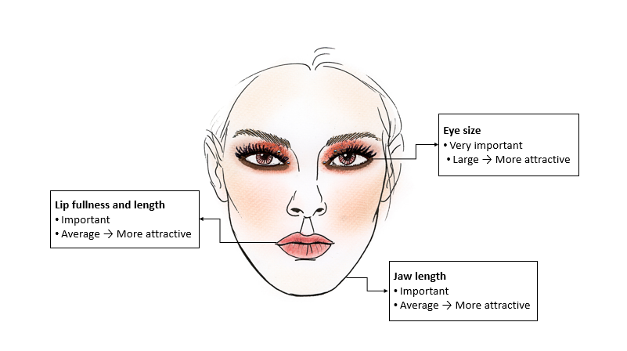

Slide 12
So What?
Advertisements should employ actresses in their 20s, with defined eyes, lips, jaw, and balanced facial ratios.
The campaign should use faces from the demographic that the targeted demographic considers most attractive.
With deepfakes, the campaign could tweak specific facial features to be more average or extreme based on the target’s preference.

Slide 13
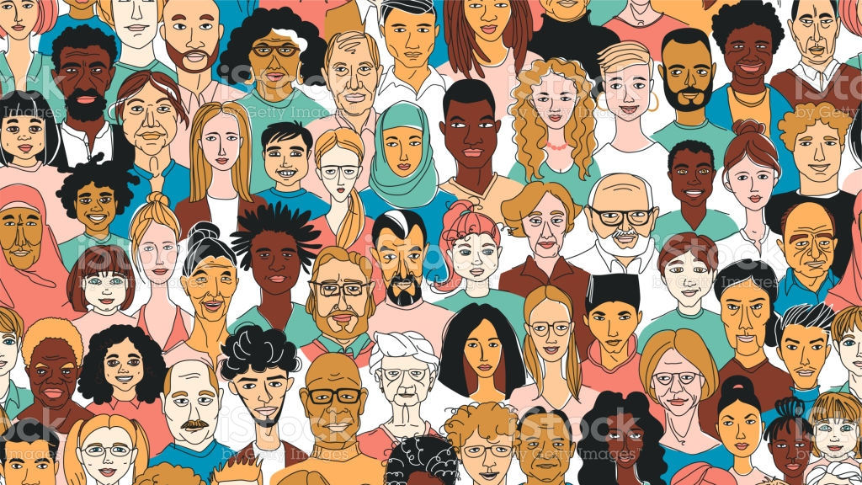
Notes
Other factors: make-up, hair, accessories, etc
Ethical concerns: contribute to unrealistic beauty standards

